Slide 1
Using mysql with node js
Paul Leszyk

Slide 2
Tools
NodeJS – Javascript framework for executing Javascript server side
Express – NodeJS backend server framework
MySQL server
Visual Studio Code – text editor
Web Browser

Slide 3
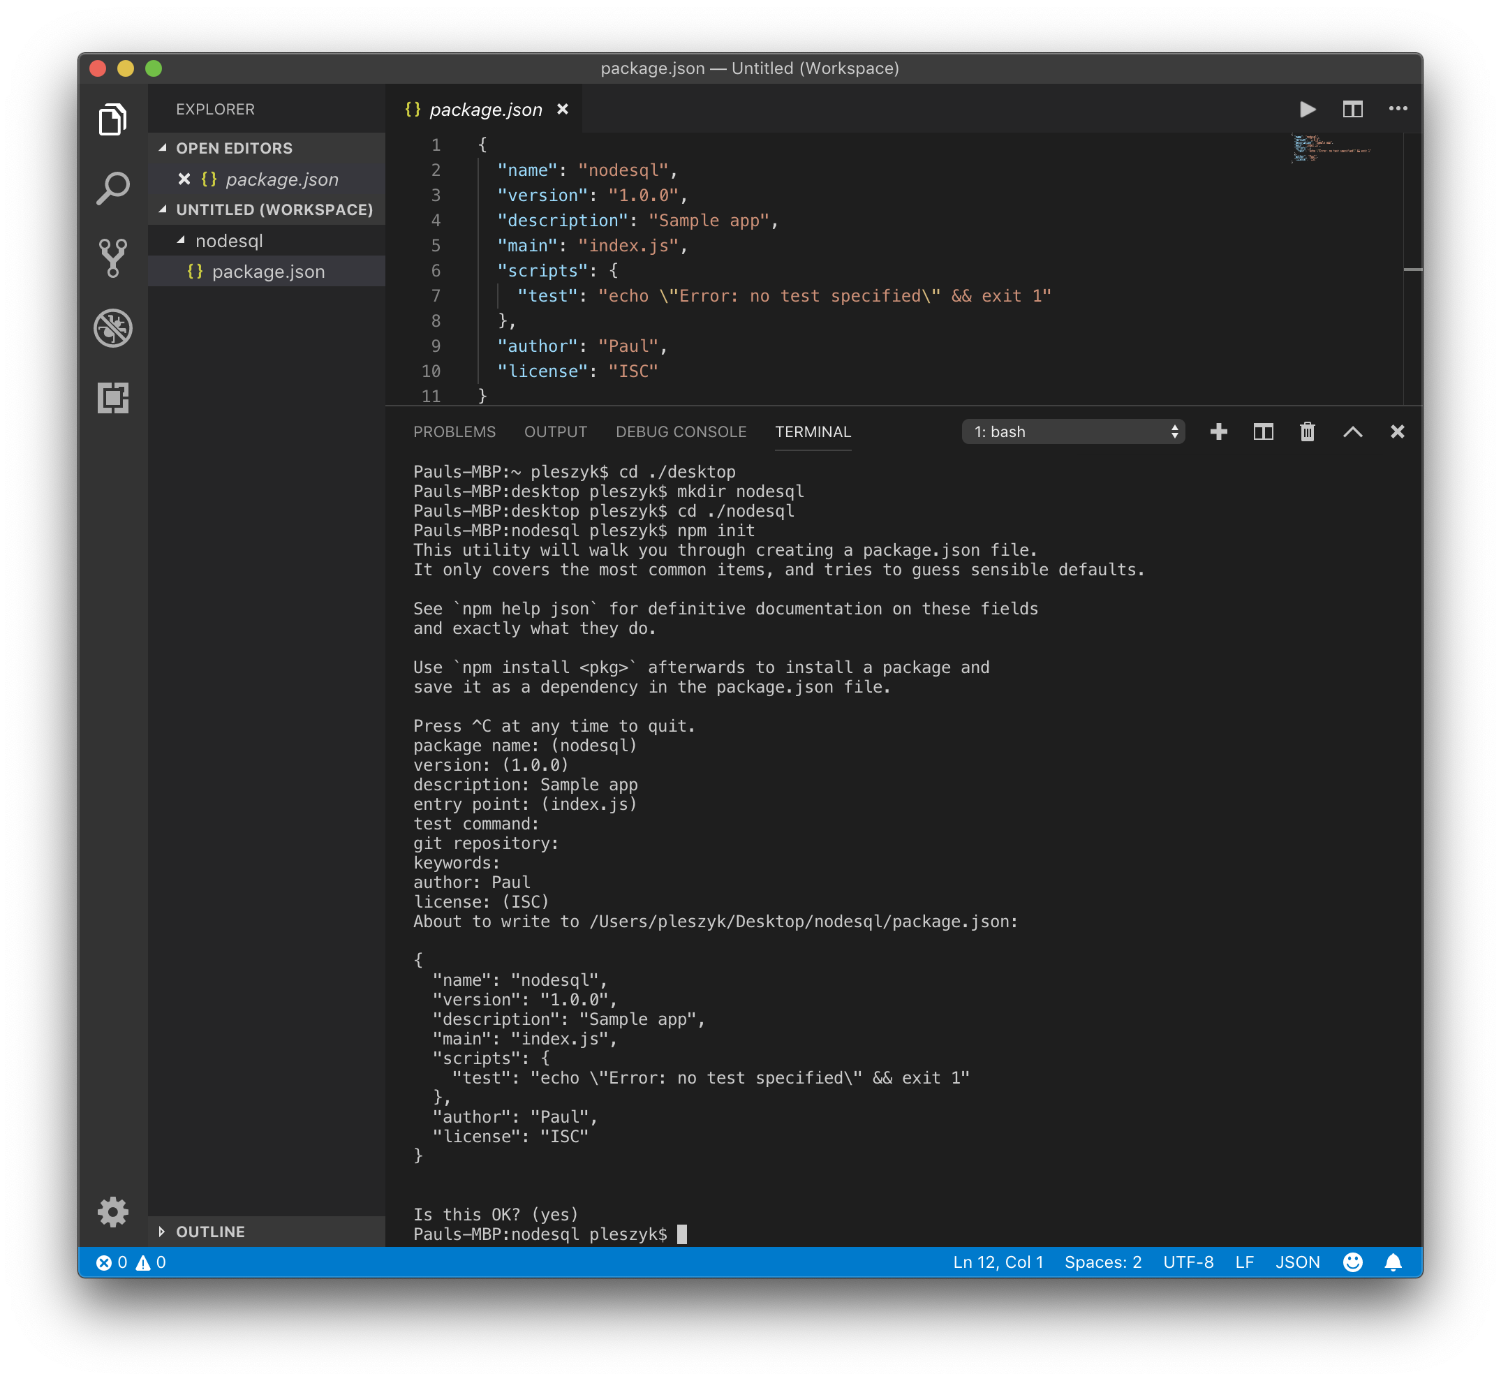

Slide 4
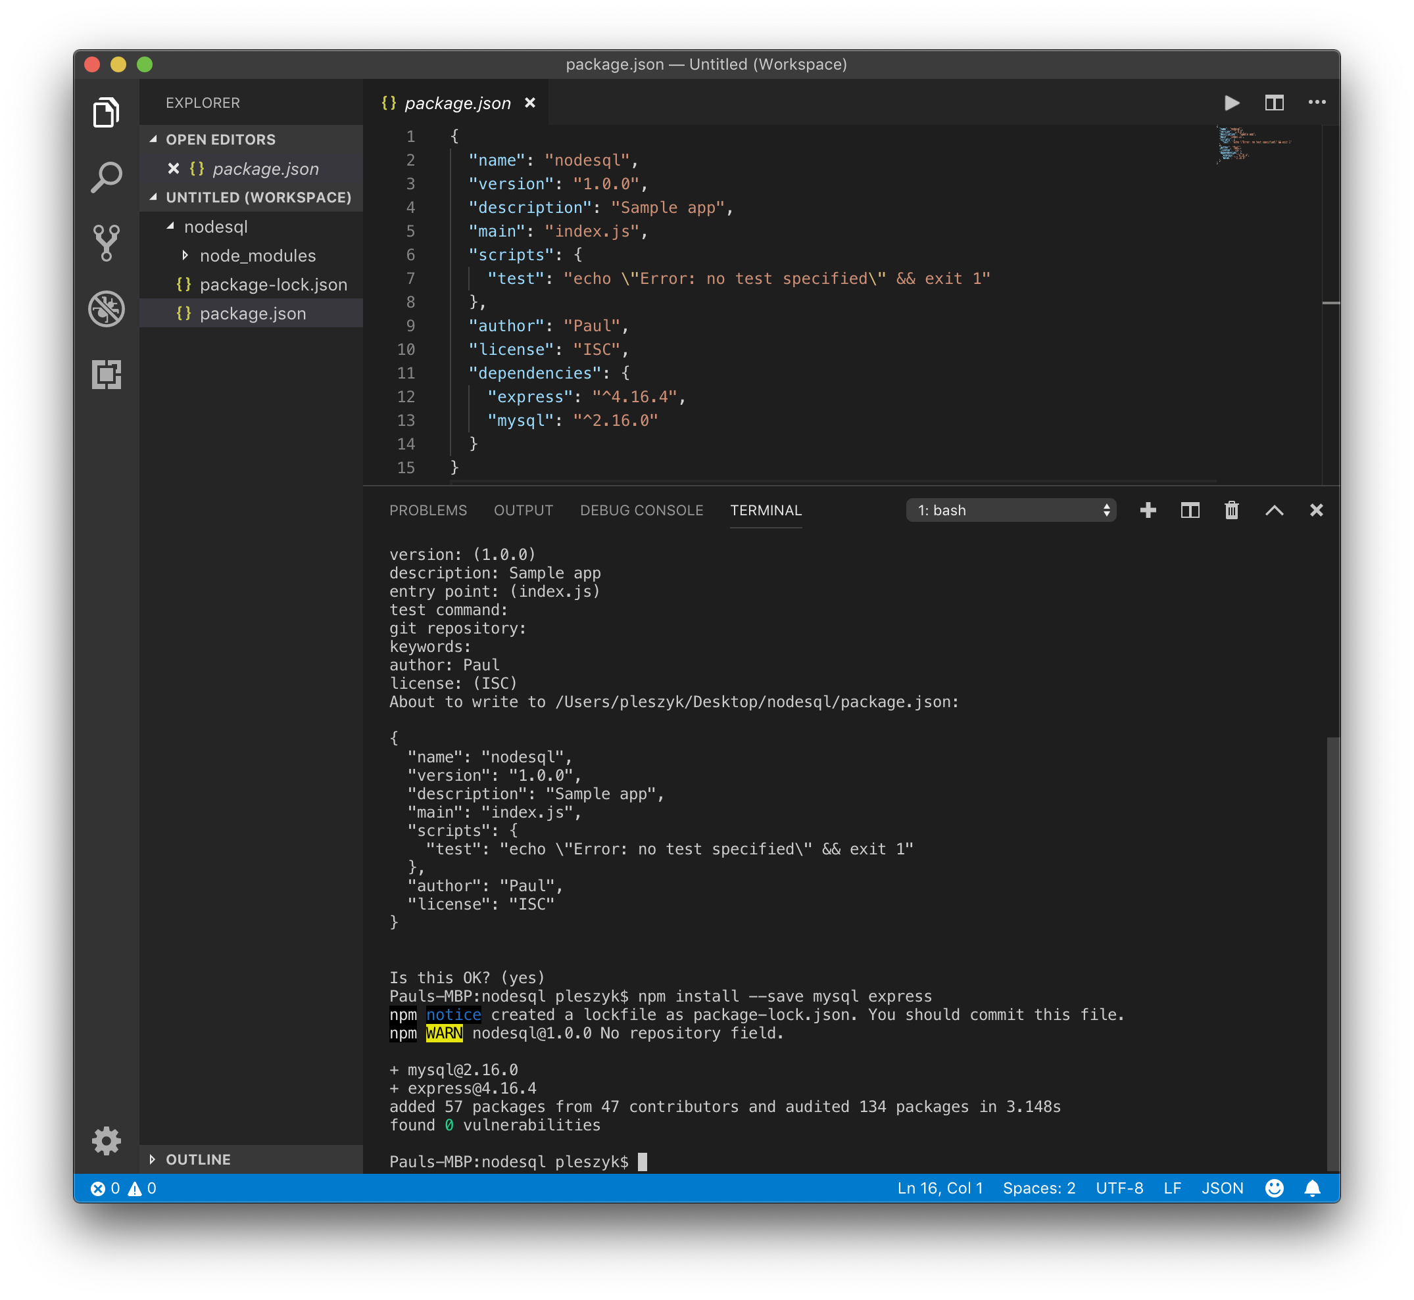

Slide 5
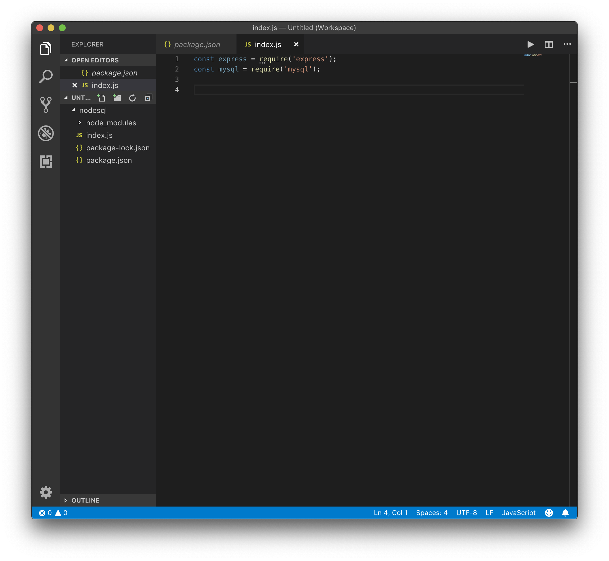

Slide 6
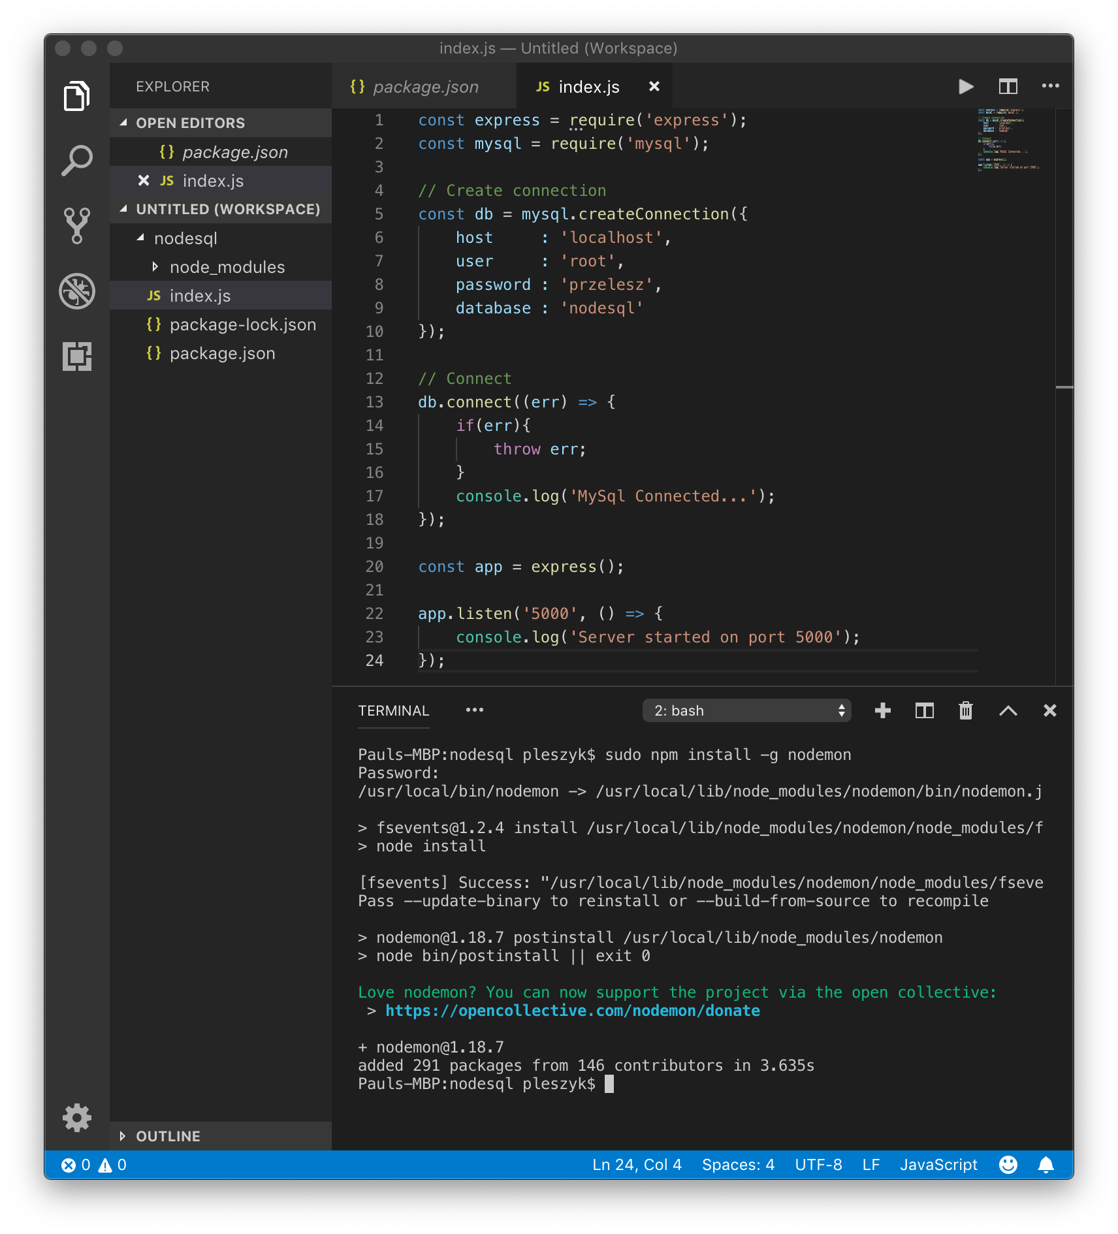

Slide 7
// Create DB
app.get('/createdb', (req, res) => {
let sql = 'CREATE DATABASE nodesql';
db.query(sql, (err, result) => {
if(err) throw err;
console.log(result);
res.send('Database created...');
});
});
// Create table
app.get('/createpoststable', (req, res) => {
let sql = 'CREATE TABLE posts(id int AUTO_INCREMENT, title VARCHAR(255), body VARCHAR(255), PRIMARY KEY(id))';
db.query(sql, (err, result) => {
if(err) throw err;
console.log(result);
res.send('Posts table created...');
});
});
// Insert post 1
app.get('/addpost1', (req, res) => {
let post = {title:'Post One', body:'This is post number one'};
let sql = 'INSERT INTO posts SET ?';
let query = db.query(sql, post, (err, result) => {
if(err) throw err;
console.log(result);
res.send('Post 1 added...');
});
});
// Insert post 2
app.get('/addpost2', (req, res) => {
let post = {title:'Post Two', body:'This is post number two'};
let sql = 'INSERT INTO posts SET ?';
let query = db.query(sql, post, (err, result) => {
if(err) throw err;
console.log(result);
res.send('Post 2 added...');
});
});

Slide 8
// Select posts
app.get('/getposts', (req, res) => {
let sql = 'SELECT * FROM posts';
let query = db.query(sql, (err, results) => {
if(err) throw err;
console.log(results);
res.send('Posts fetched...');
});
});
// Select single post
app.get('/getpost/:id', (req, res) => {
let sql = `SELECT * FROM posts WHERE id = ${req.params.id}`;
let query = db.query(sql, (err, result) => {
if(err) throw err;
console.log(result);
res.send('Post fetched...');
});
});
// Update post
app.get('/updatepost/:id', (req, res) => {
let newTitle = 'Updated Title';
let sql = `UPDATE posts SET title = '${newTitle}' WHERE id = ${req.params.id}`;
let query = db.query(sql, (err, result) => {
if(err) throw err;
console.log(result);
res.send('Post updated...');
});
});
// Delete post
app.get('/deletepost/:id', (req, res) => {
let newTitle = 'Updated Title';
let sql = `DELETE FROM posts WHERE id = ${req.params.id}`;
let query = db.query(sql, (err, result) => {
if(err) throw err;
console.log(result);
res.send('Post deleted...');
});
});

Slide 9
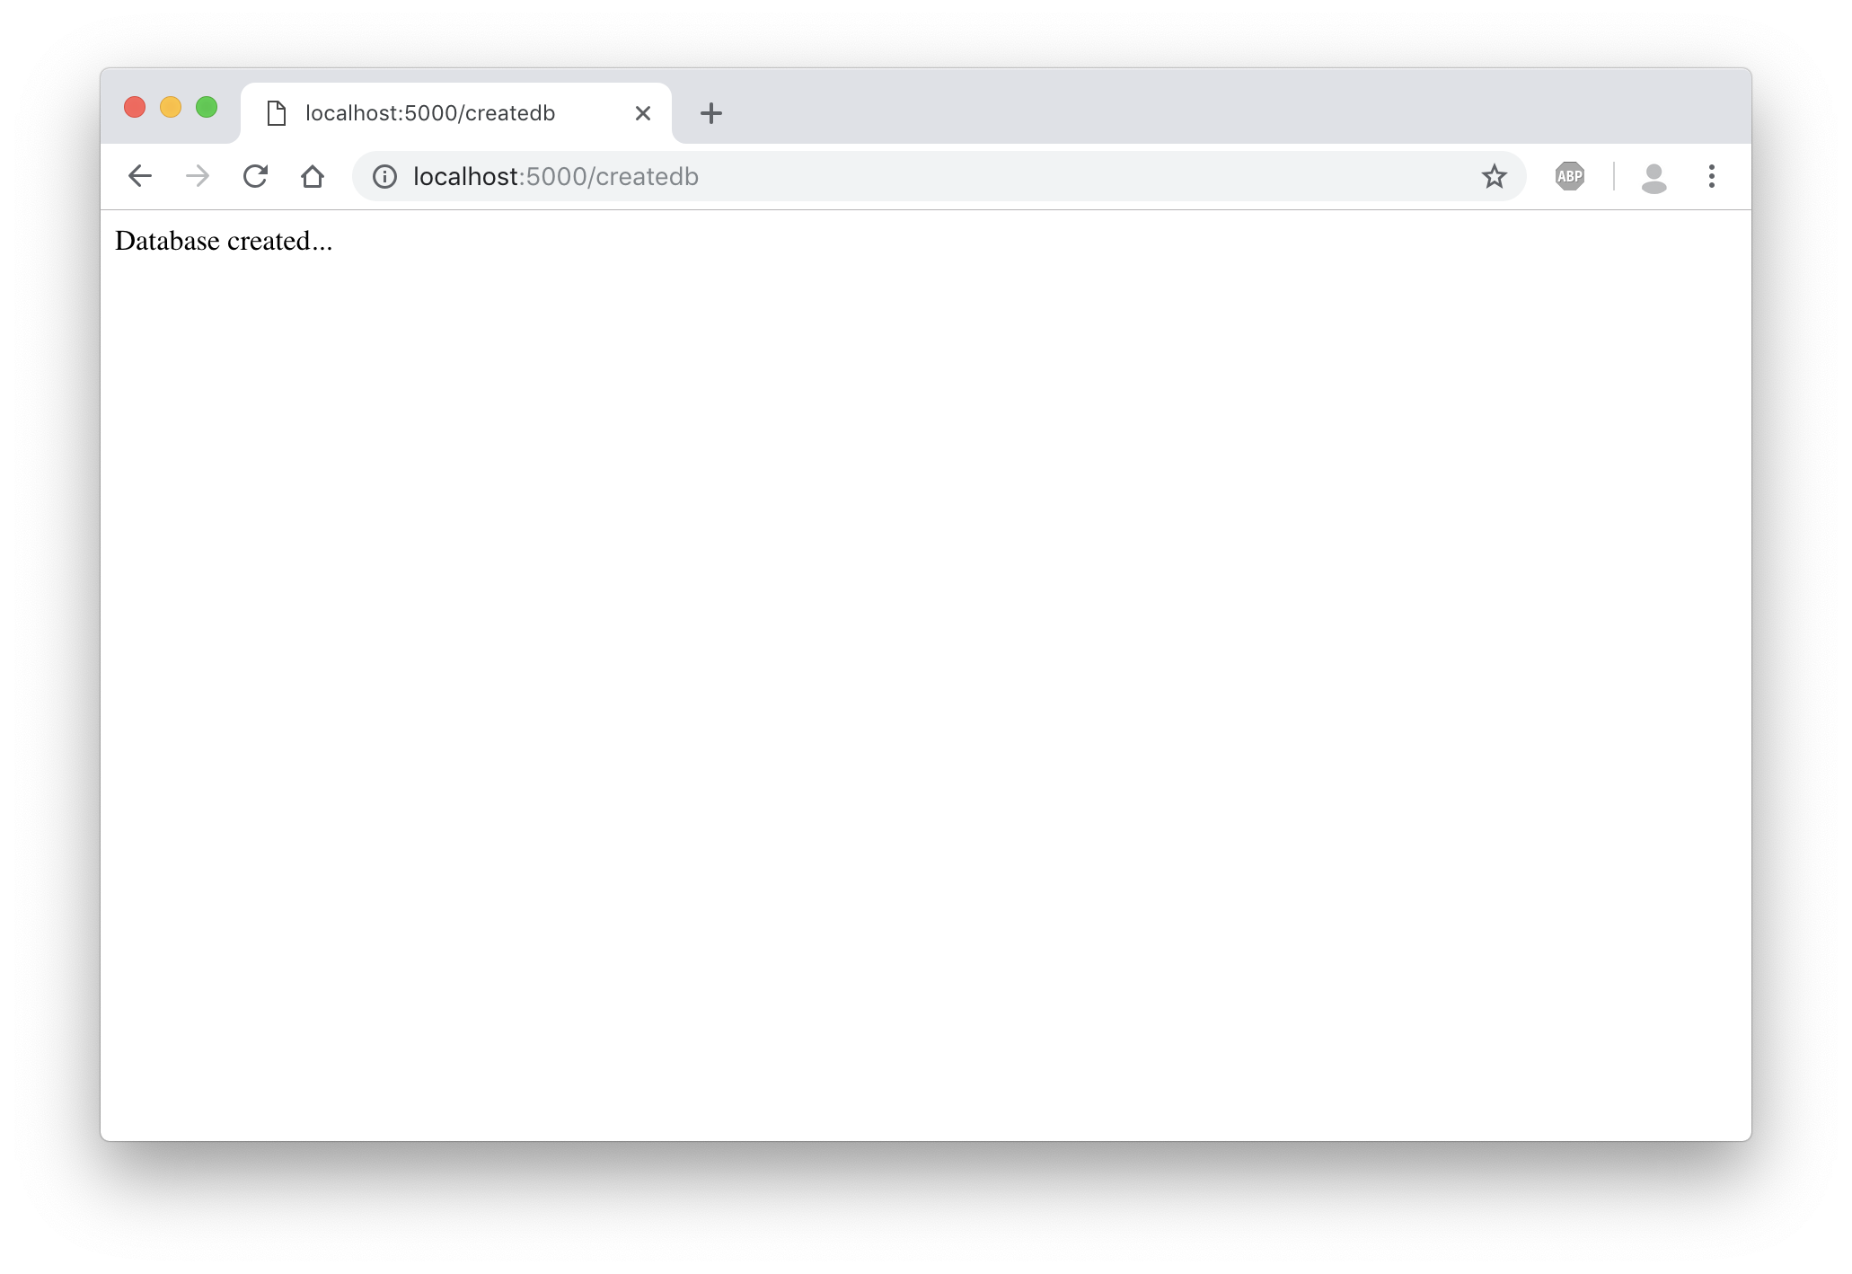

Slide 10
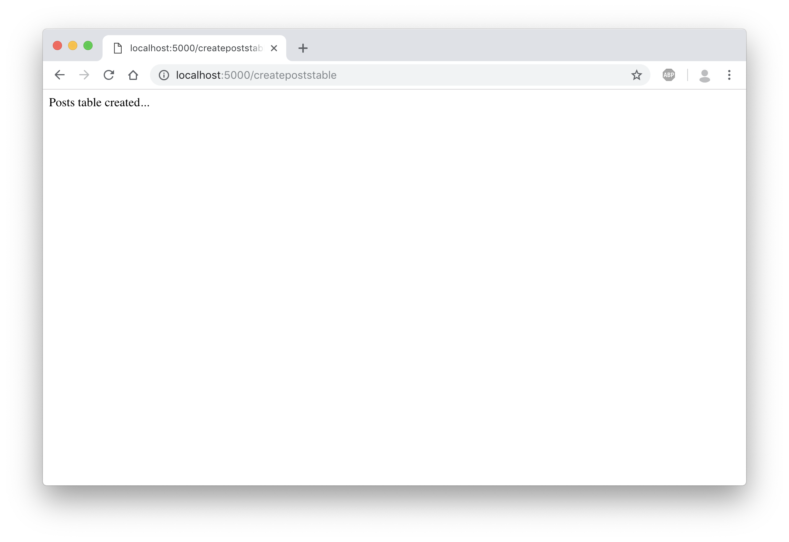

Slide 11
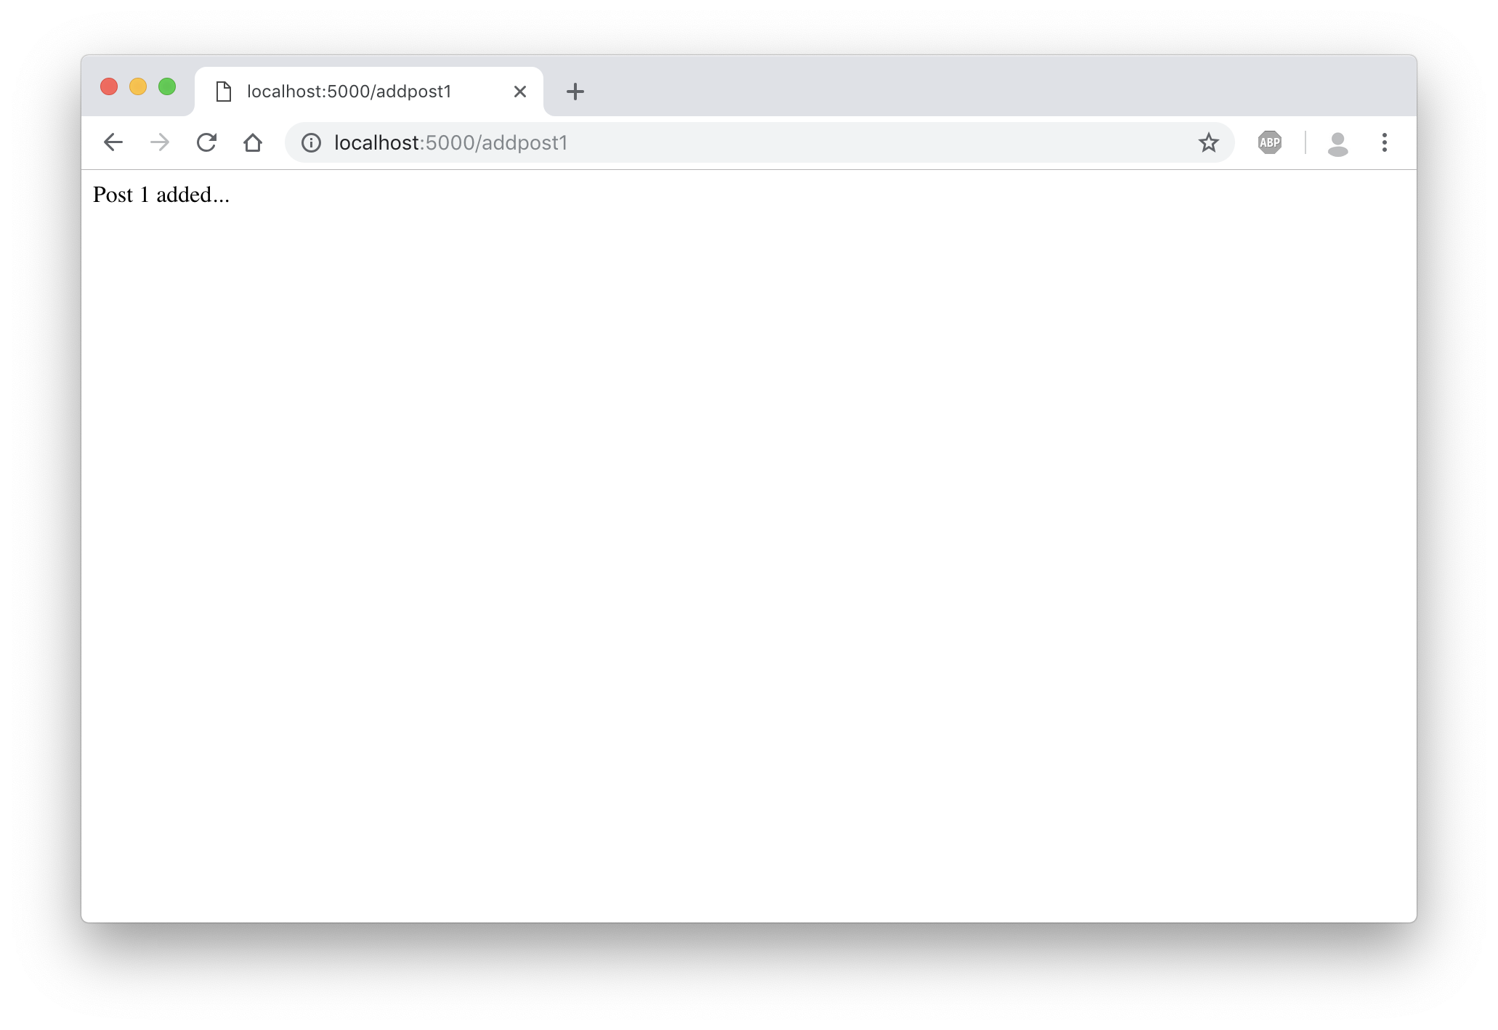

Slide 12
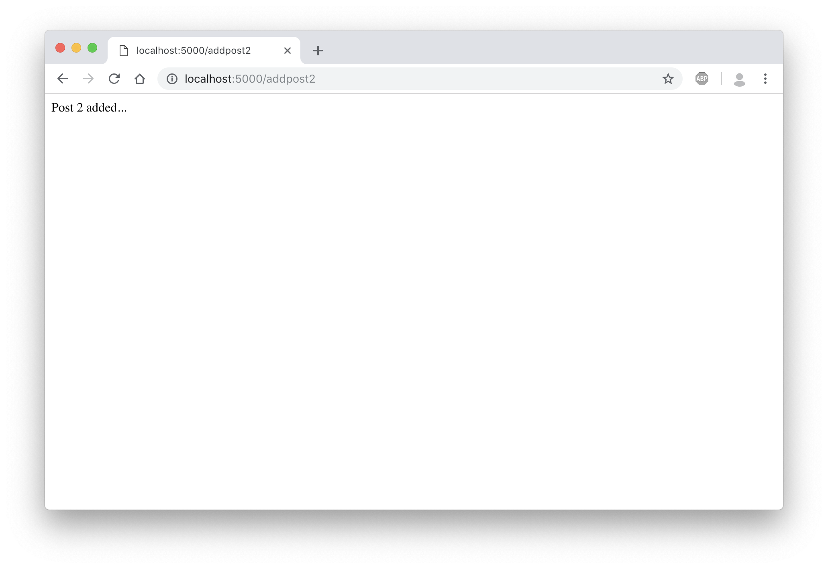

Slide 13
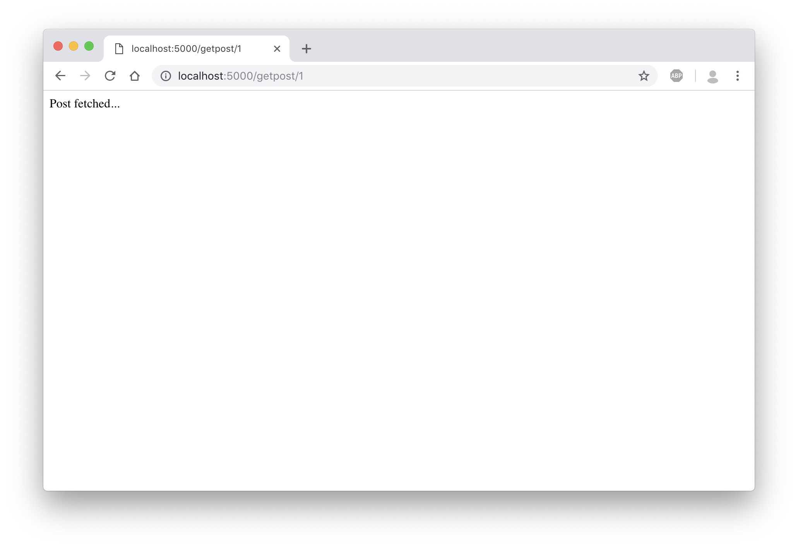

Slide 14
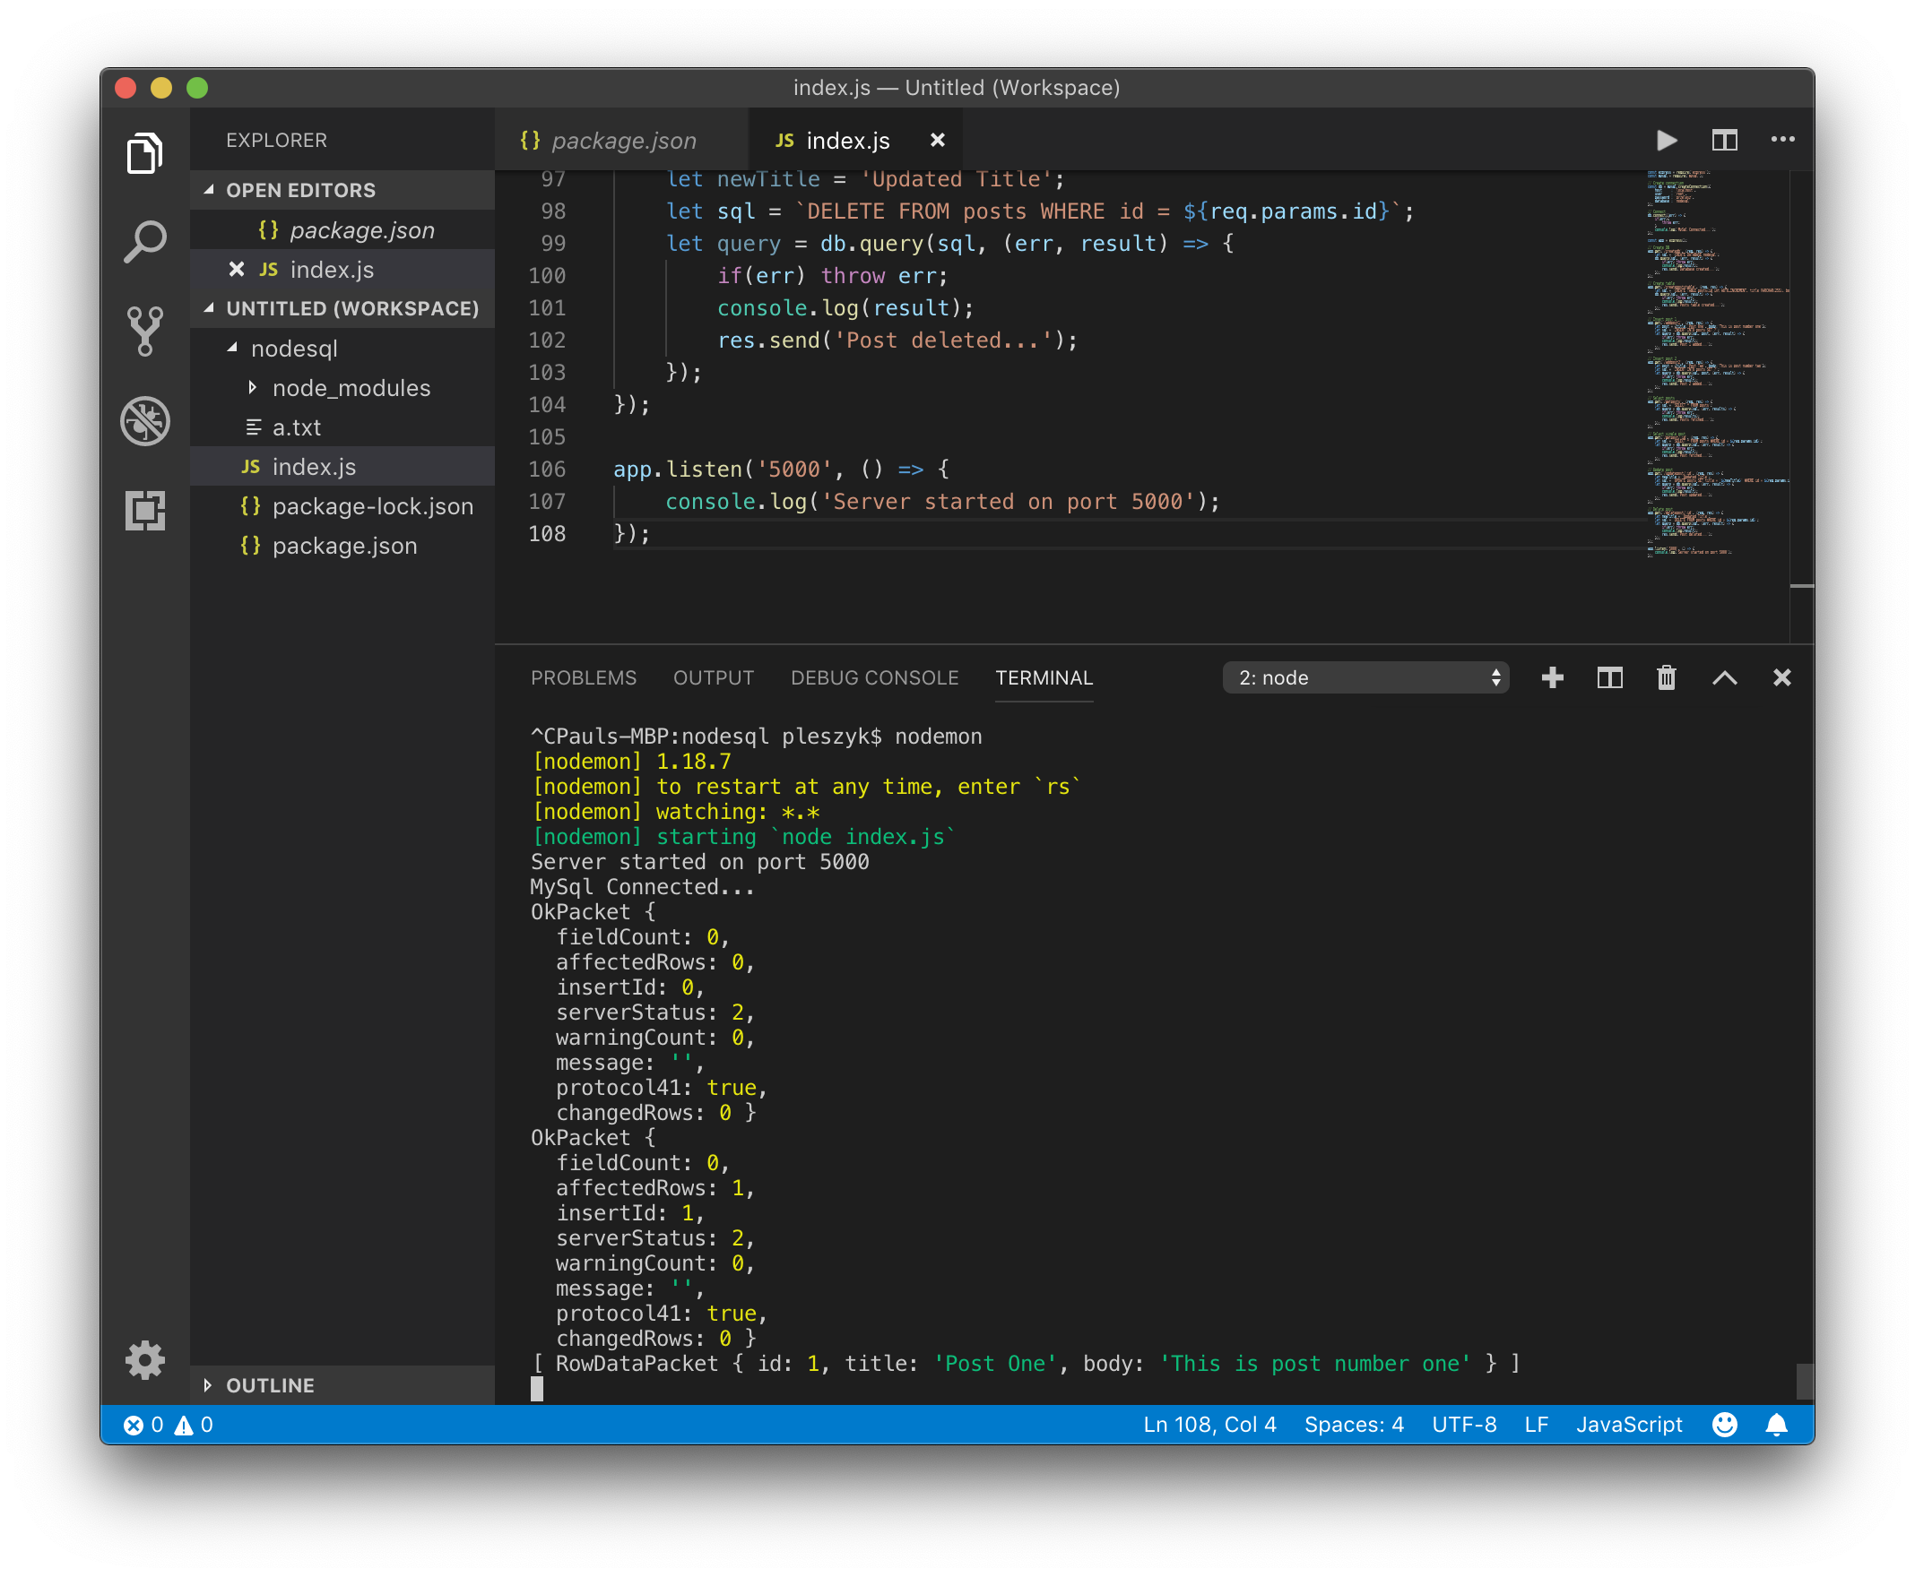

Slide 15


Slide 16
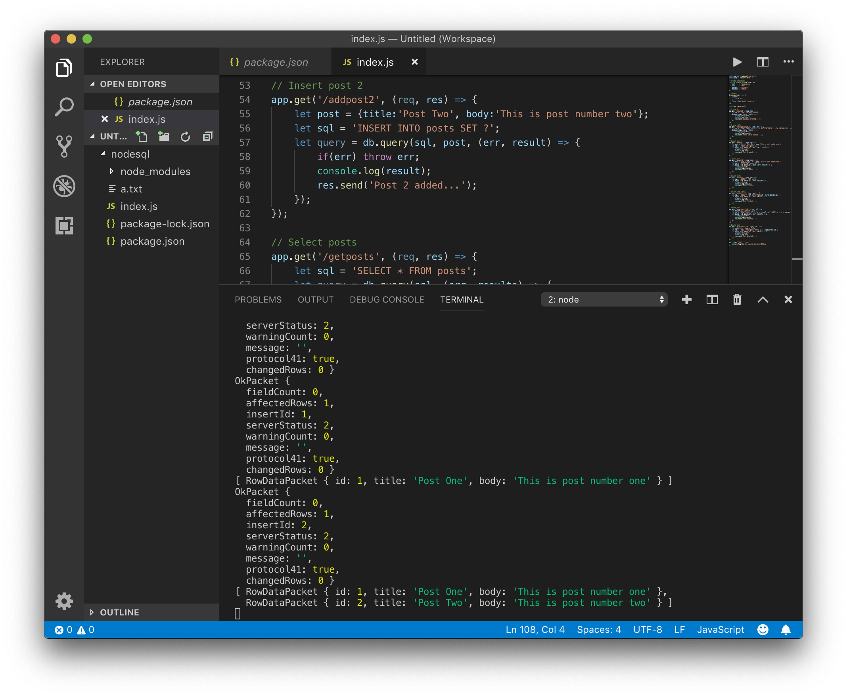

Slide 17
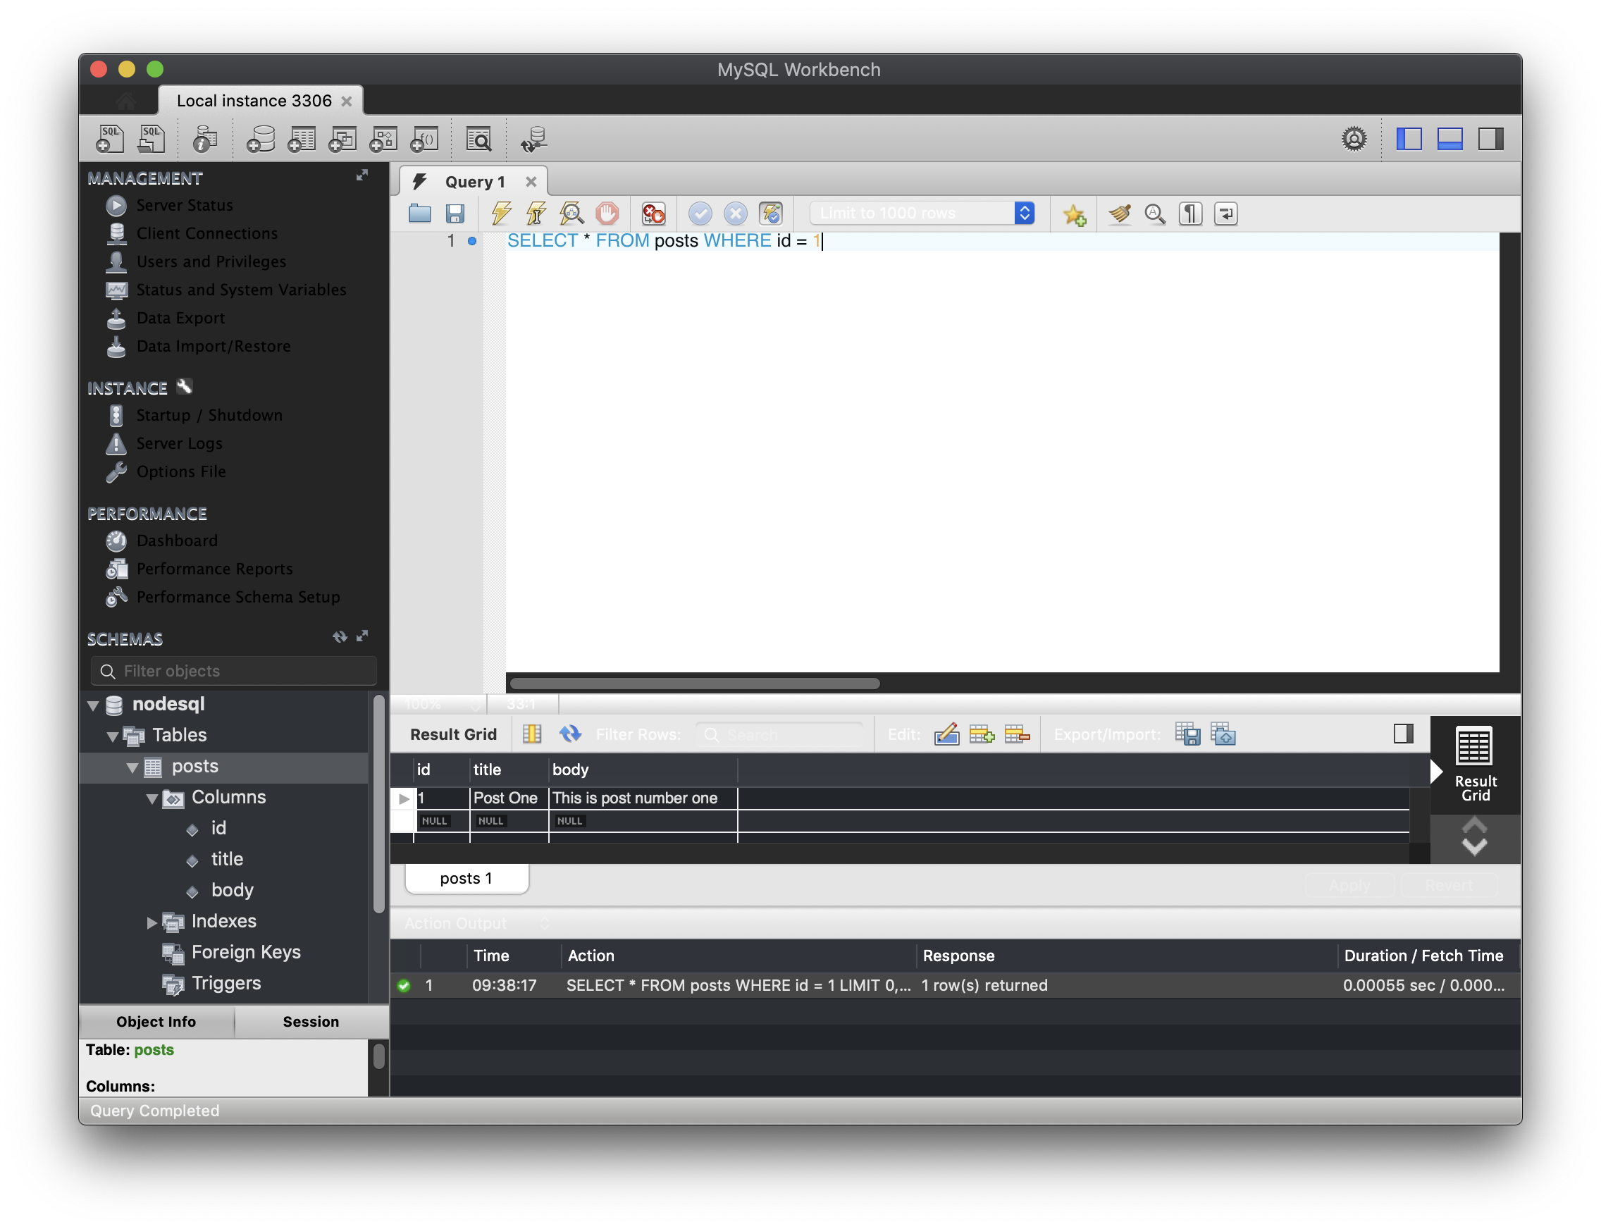

Slide 18
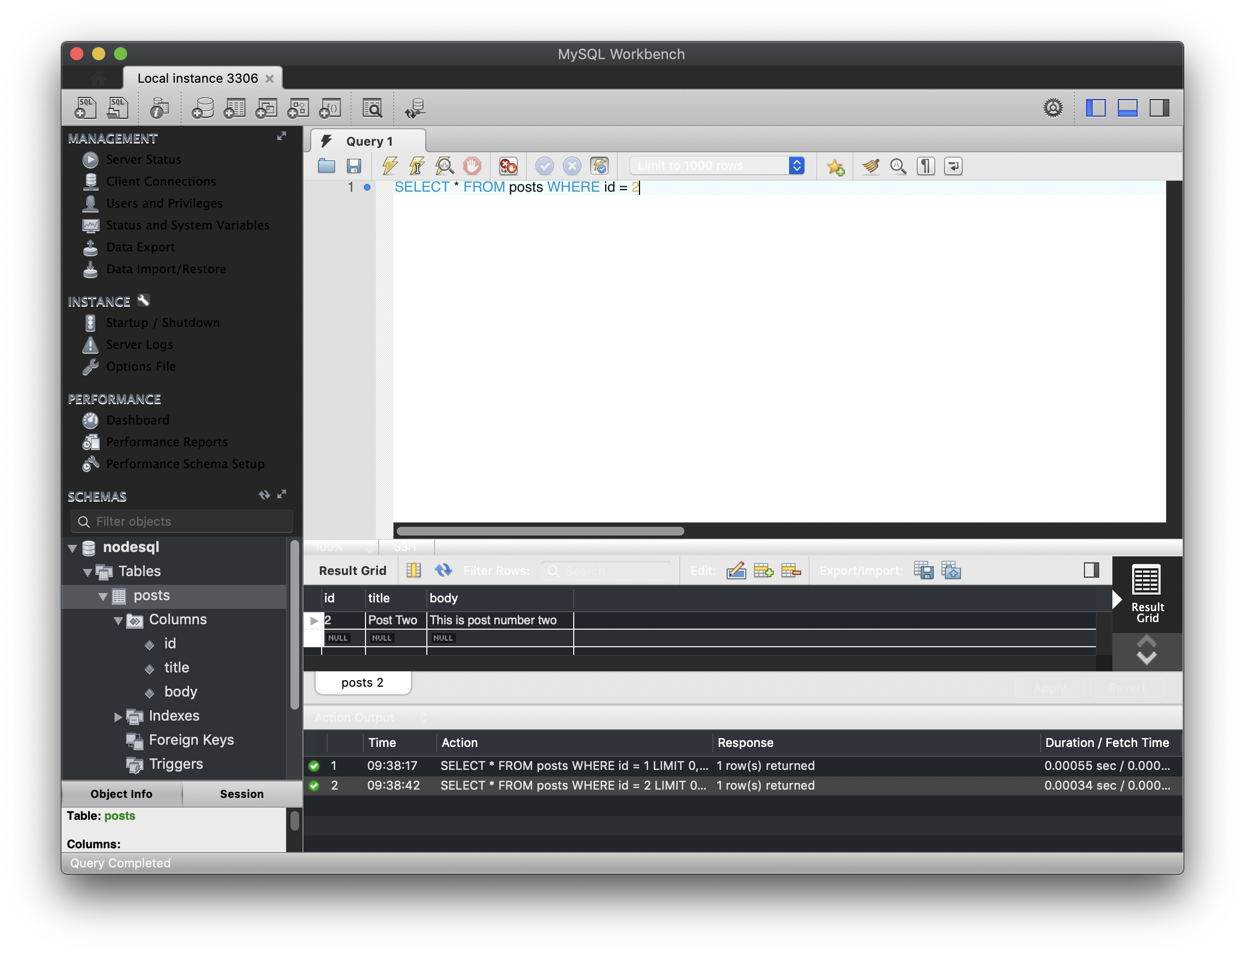

Slide 19


Slide 20
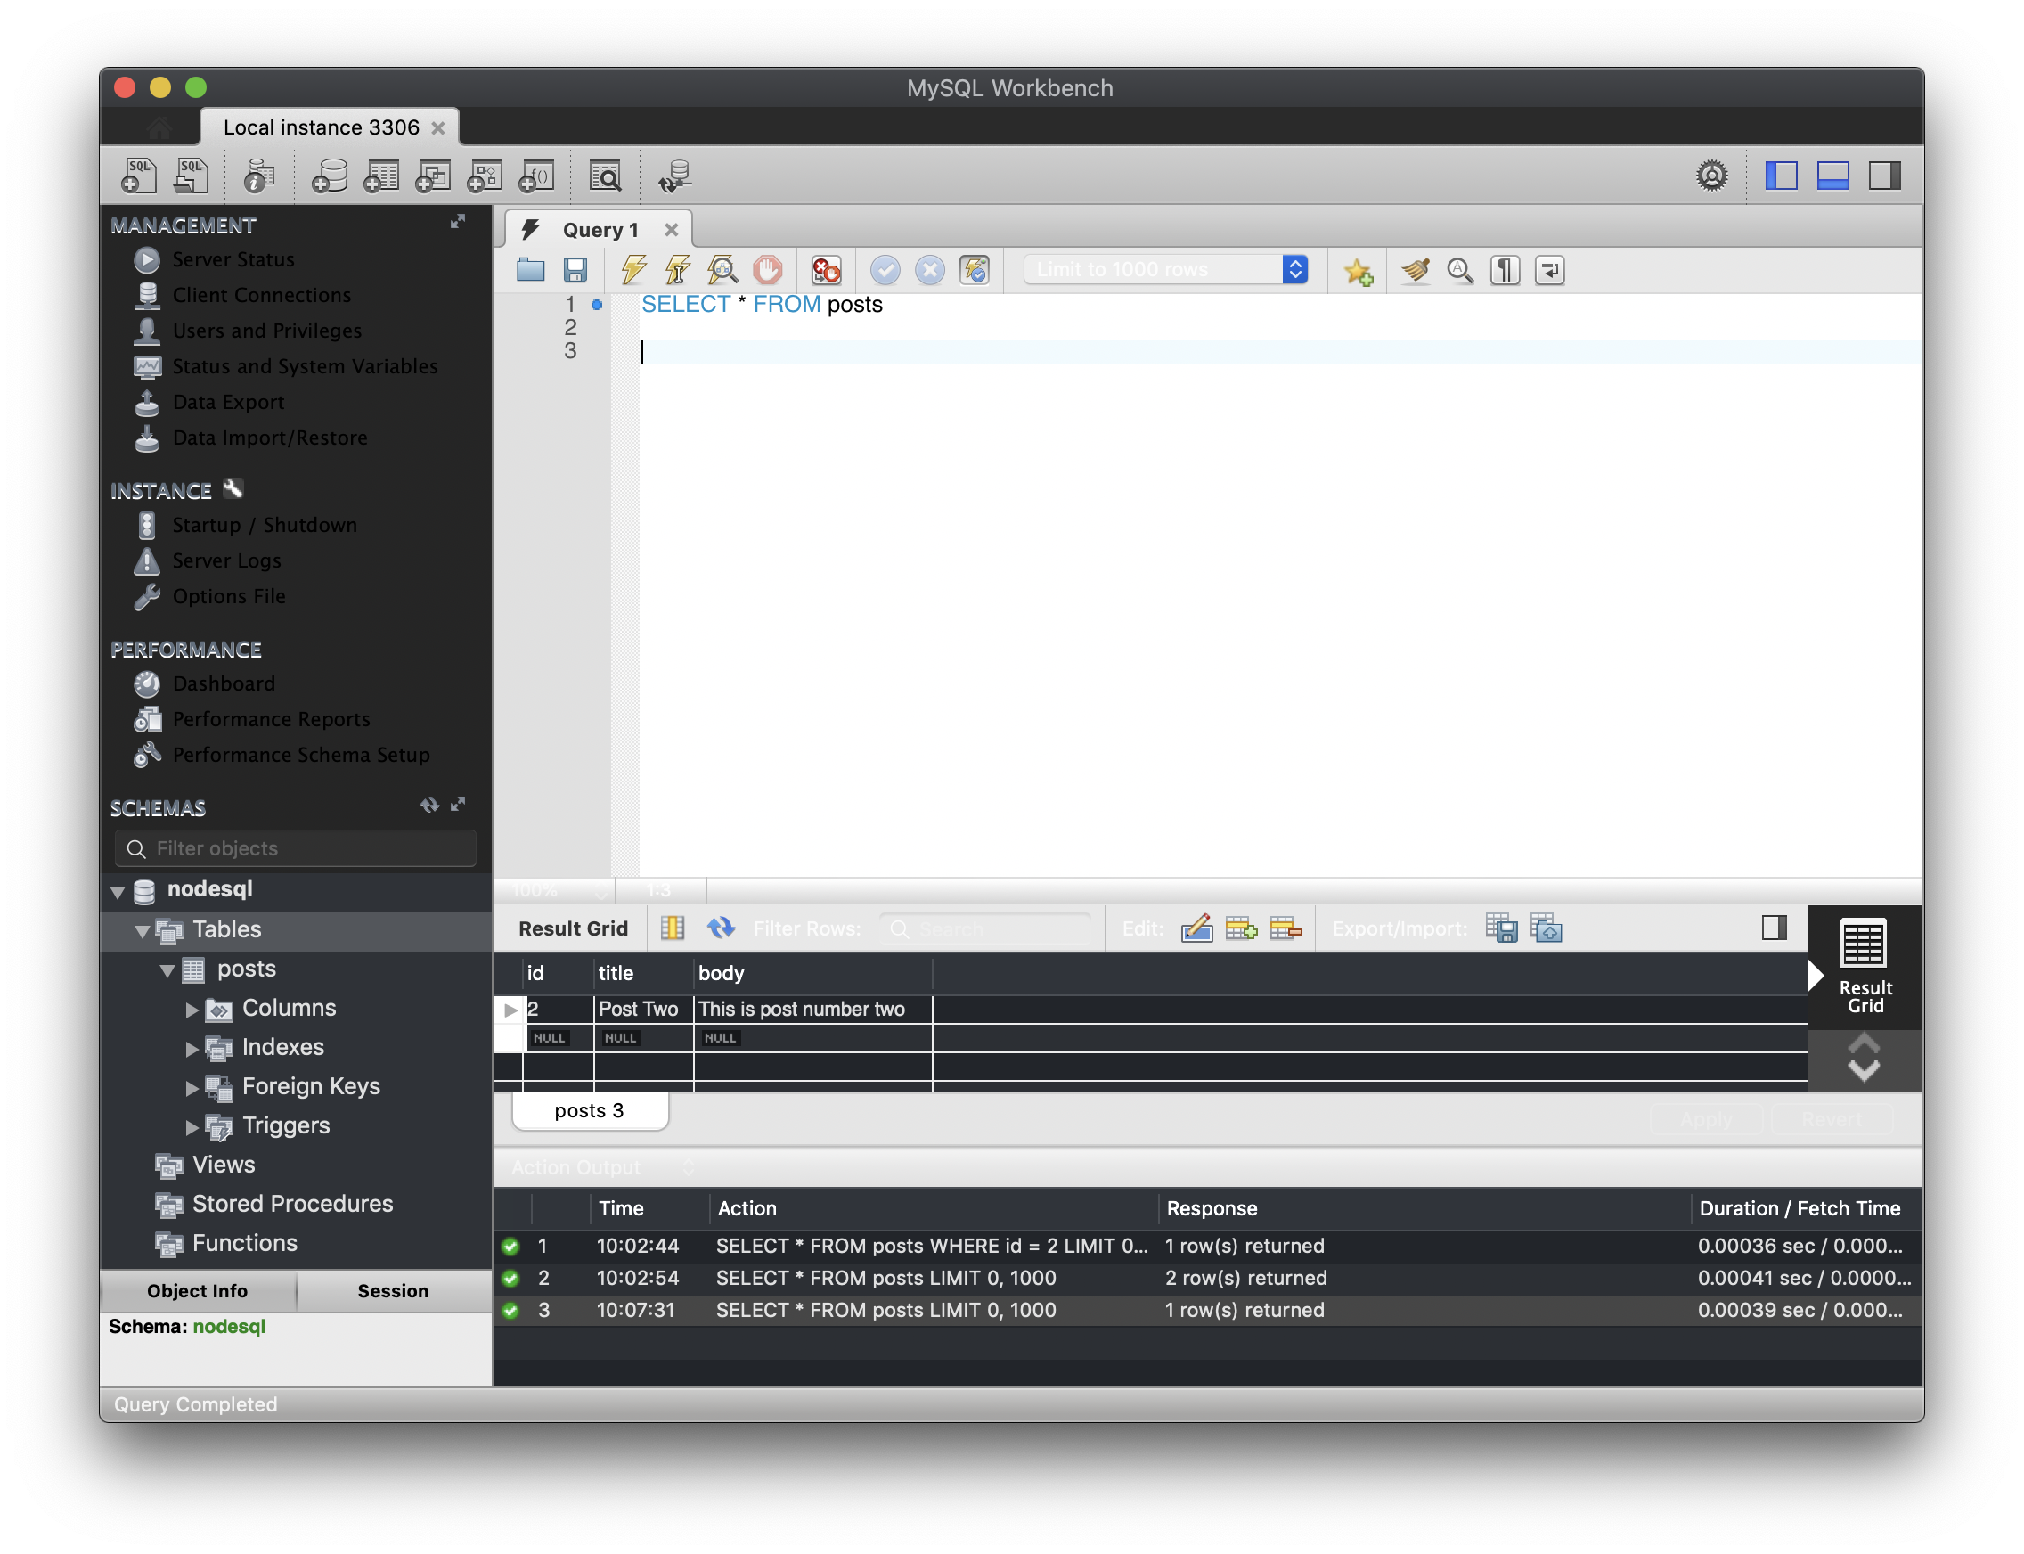

Slide 21
Conclusion
To improve I would:
Create a user interface (frontend)
Add restrictions for certain users from a login (similar to an actual blog)
Include prevention from SQL injection attacks

